Slide 1
Life Expectancy (2024)
Across continents and within

Slide 2
Findings

Slide 3
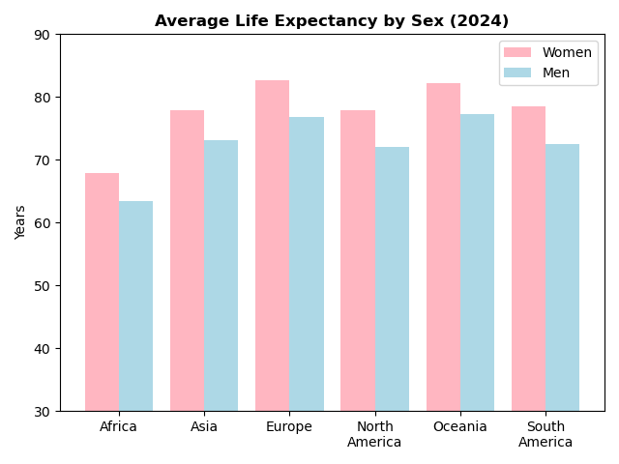
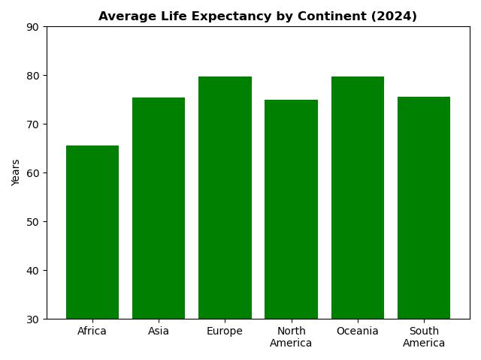
Continent Life Expectancy by Sex and Averaged
The highest average life expectancies we found globally are in Europe

Slide 4
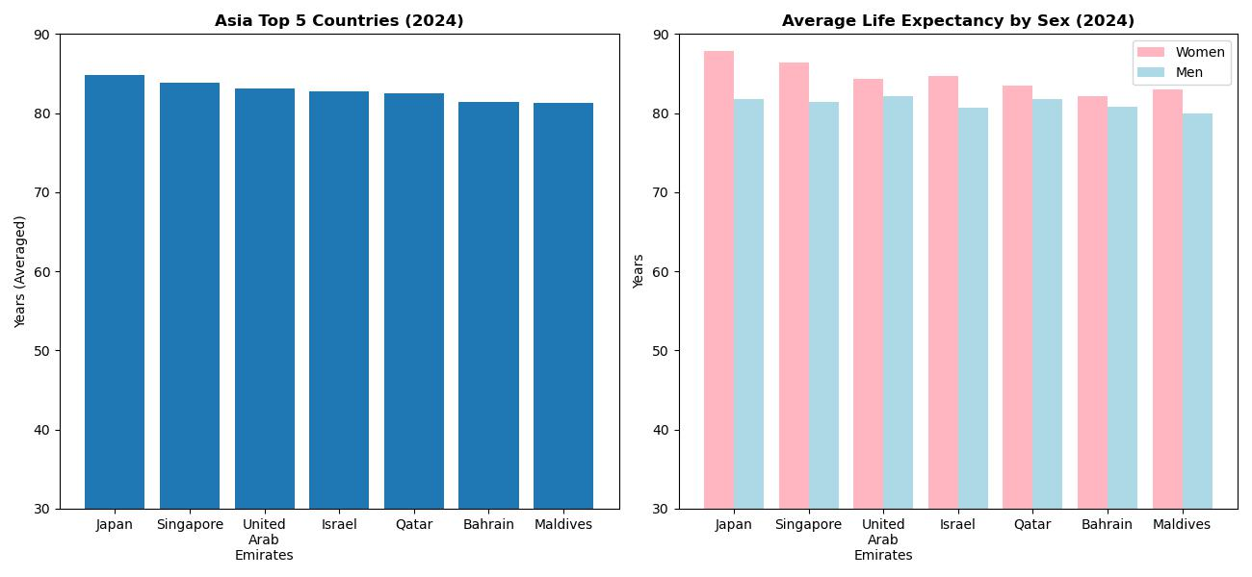
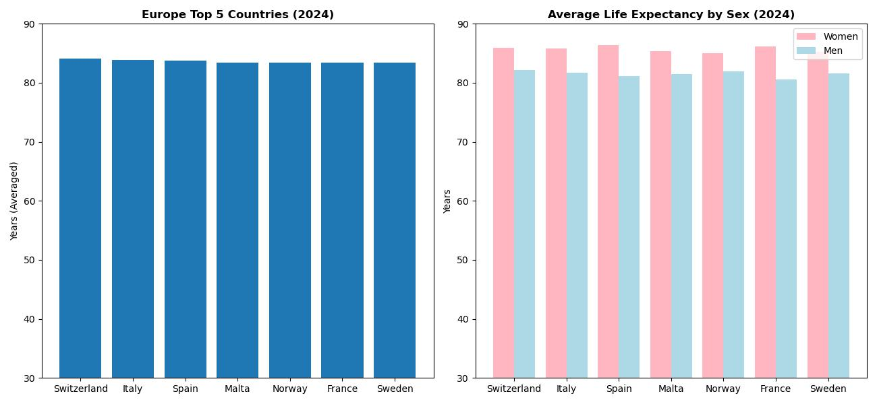
Top 5 Countries per Continent
Asia
The countries with the highest life expectancy are Japan for Asia and Switzerland for Europe
Europe

Slide 5
Life Expectancy – the average period a person may expect to live
Lifestyle Factors: diet, activity and substance use (e.g., tobacco or alcohol) and/or abuse.
Socioeconomic Factors: social support, income, education and access to healthcare
Environmental Factors: air and water quality and living conditions
Medical Technology and Advancements
Notes:
Establish with audience the possible reasons for these numbers and which ones to be focused on based on data constraints and plurality of variables

Slide 6
Objective Variables Measurable Nationally
Certain factors such as lifestyle requires a good bit of data to accurately account for
It will be more efficient to use an aggregate metric for a nation and extrapolate to factors that depend on it
For this EDA, Gross Domestic Product (GDP) will be used to infer the status of certain factors such as
Social Support
Income
Public Health Measures
Medical Technology
General Living Conditions

Slide 7
Gross Domestic Product – the total value of goods produced and services provided in a country during one year
Personal Consumption – spending by households on goods and services (the largest component of GDP)
Business Investments – spending by businesses on capital goods (e.g., machinery, equipment, buildings, inventory, etc.)
Government Spending – spending by government on goods and services including salaries for government employees, infrastructure and defense
Net Exports – the difference between exports and imports
Notes:
Connect bullets from last slide to components
Social support, medical technologies and public health measures to Government Spending
Income and general living conditions to Personal Consumption
Overlaps – Medical Technologies and General Living conditions a conjunction of personal, government and business investments
Emphasize that while there are a good bit of factors going into this that also affect life expectancy, the focus needs to be on areas that can be handled. If goal is government expenditures focus on government responsibility to the people. If the goal is to alter investment focus on the interplay between net export, business investments and government spending etc.

Slide 8
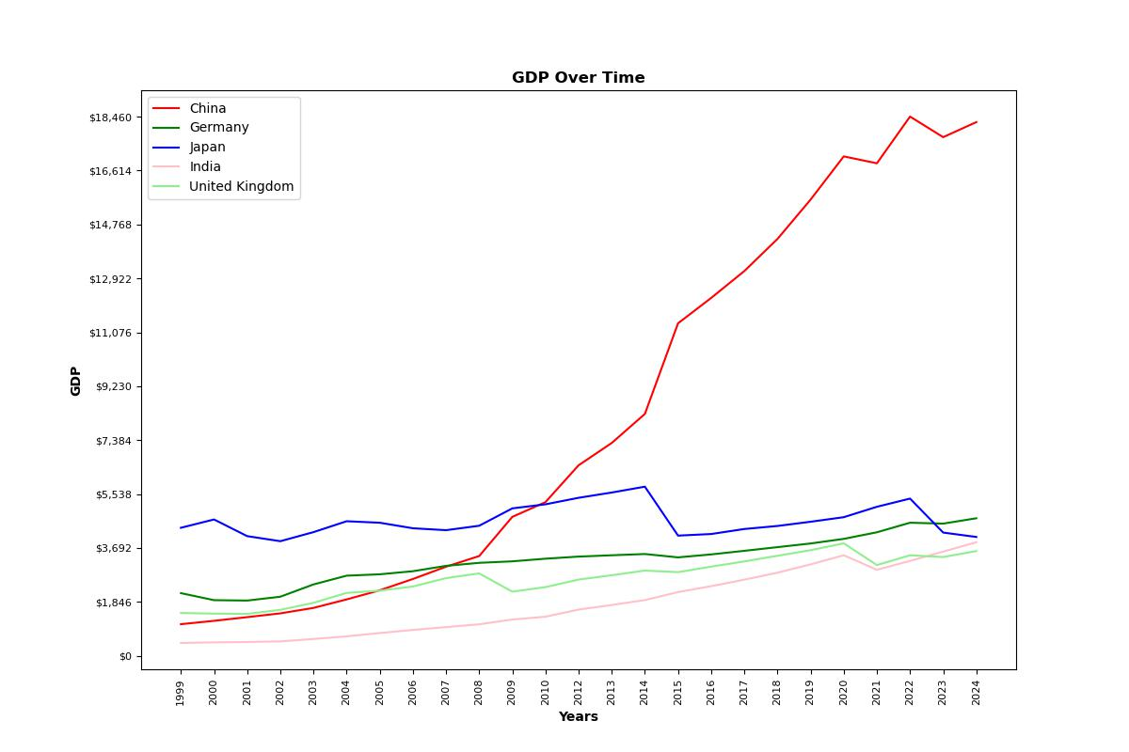
Highest GDP Globally Over Time
The highest recorded GDP from the data as of 2024 is China followed by Germany
Notes:
Go over what GDP findings say and what GDP generally says about the country overall in terms of global trade. Relate this to public service expenditures

Slide 9
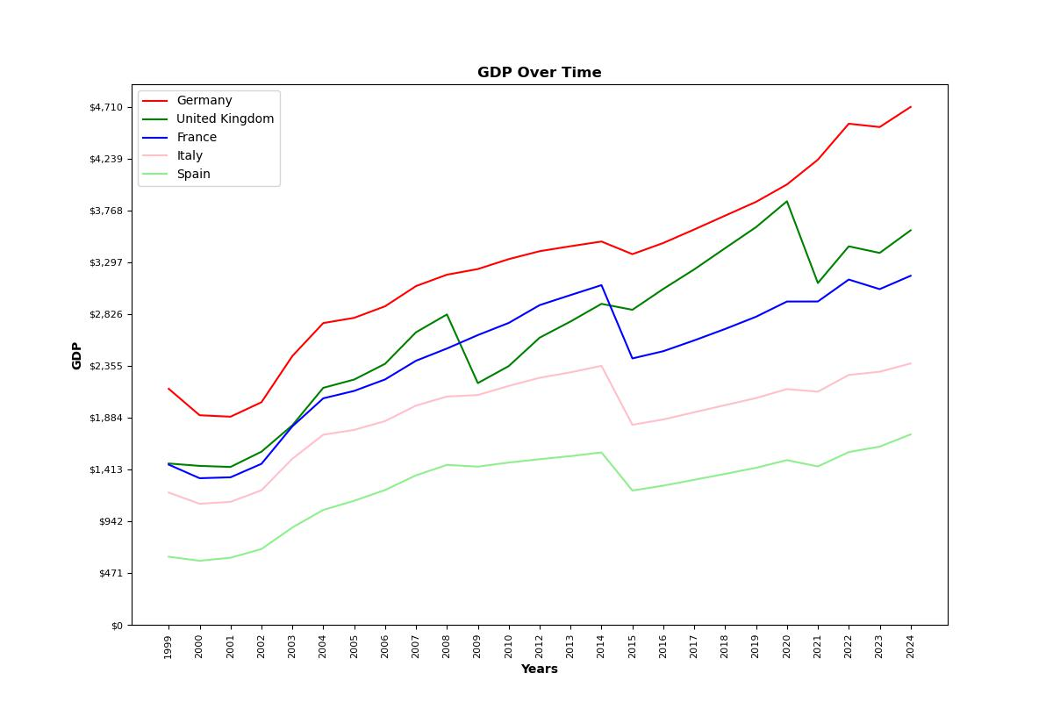
Europe GDP Over Time

Slide 10
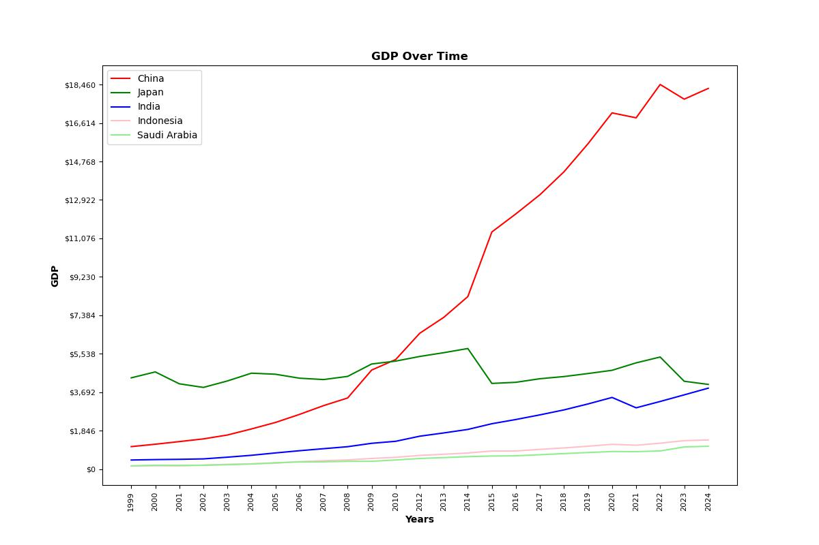
Asia GDP Over Time
Notes:
Note that neither China nor Germany were represented by the top 5 life expectancy per their continents. Note also that Japan (#2) was. Since there was a component of economic interchange in life expectancy, important to note that GDP itself may not be a good measure, but it can be. Now look to allocation of assets (by target audience gov., business, etc.) to better utilize their component of GDP to maximize life expectancy.

Slide 11
Summary

Slide 12
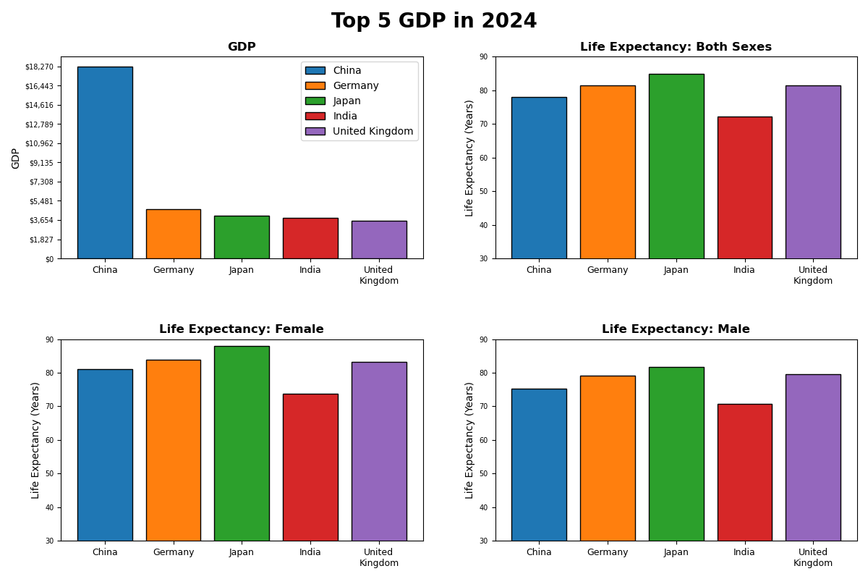
Top 5 GDP Comparison of Variables: Globally
Notes:
Reemphasize the disparities between GDP and life expectancy

Slide 13
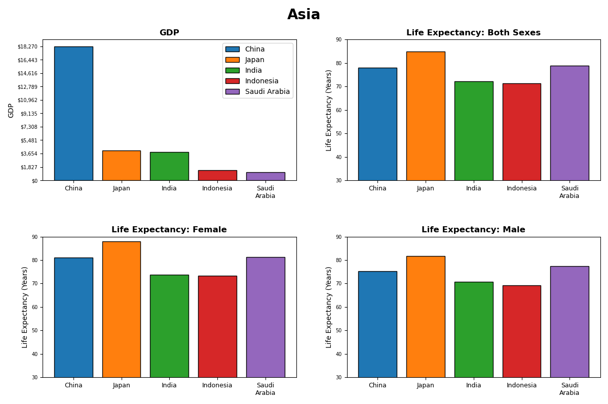
Top 5 GDP Comparison of Variables: Asia
Notes:
Note major difference between China and Japan

Slide 14
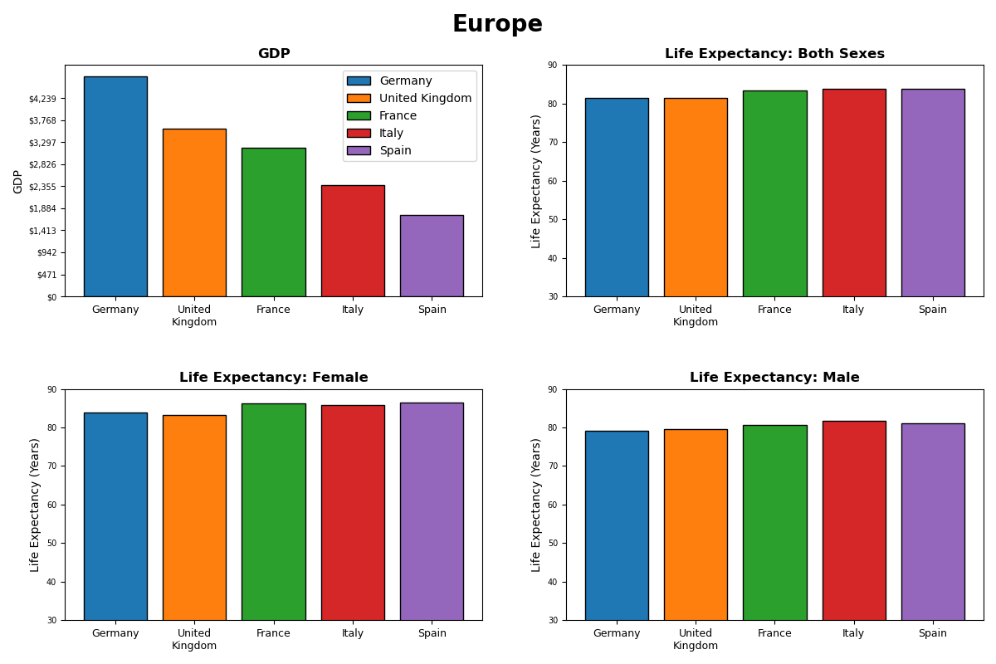
Top 5 GDP Comparison of Variables: Europe
Notes:
Note how Switzerland (highest Life Expectancy in Europe) not present in lineup

Slide 15
Notes
Bridge the gap
While some places may have a higher GDP, to extend life expectancies, the allocation of those assets may need to be reassessed.
What do investments in public health or infrastructure look like?
What business laws or latitudes are in place?
How well is international trade supported and/or incentivized?

Slide 16

Q & A

